Slide 1
Arduino Electronic Load
Habid Rascon-Ramos

Slide 2
Arduino Electronic Load Review
Overview and Goals
Hardware Development Process
Final Product
Results
Future Directions

Slide 3
Overview
Electronic Load
Consumes electric power
Voltage applied
Sinks current
Development tool
Power supply and battery testing
Current commercial options
Too expensive and overpowered

Slide 4
Goals
Open source
Cater to maker market
Make it programmable using Arduino
Deliverable: The load can maintain a 1A current draw for 1 hour at 5% accuracy

Slide 5
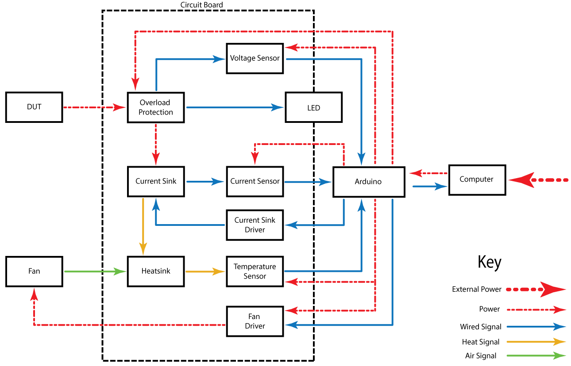
Feature Block Diagram

Slide 6
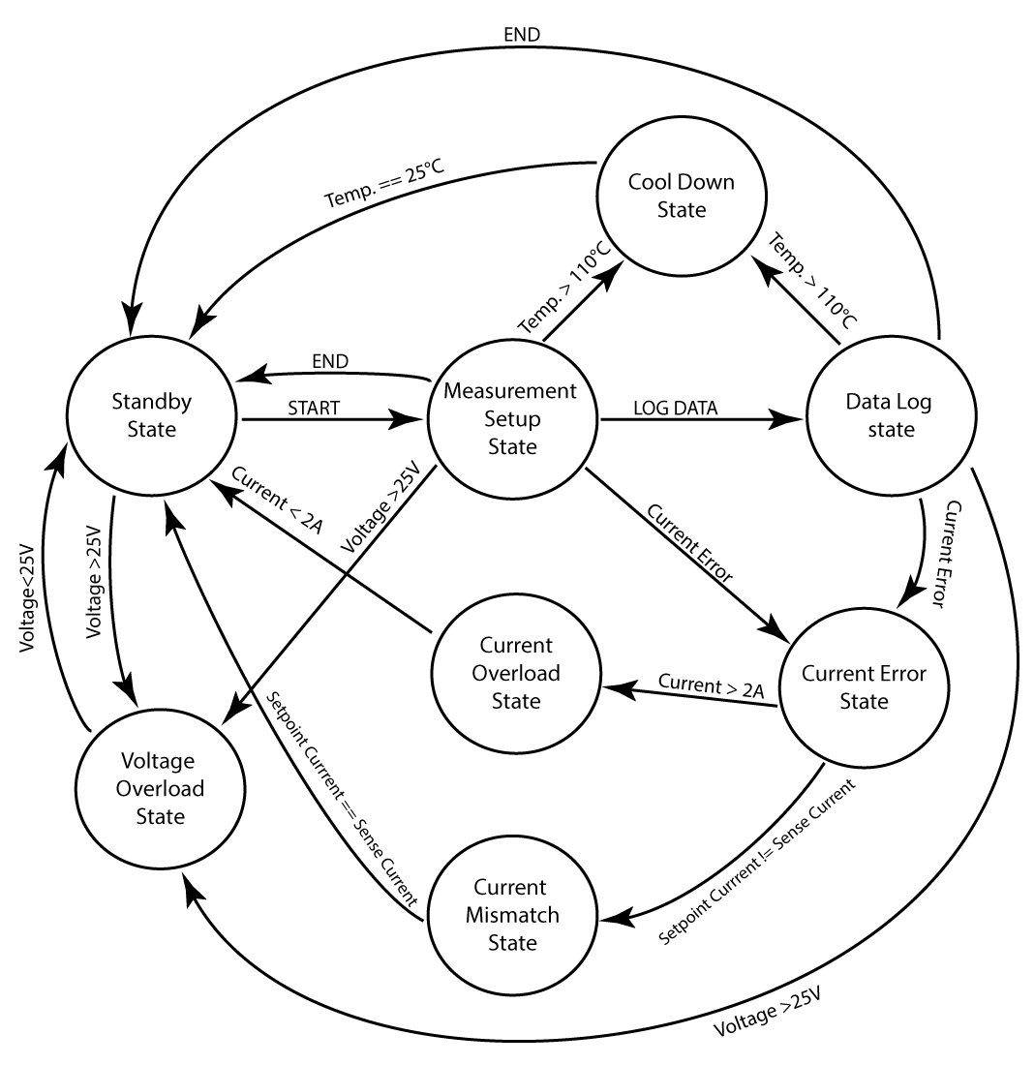
State Machine Flow Diagram

Slide 7
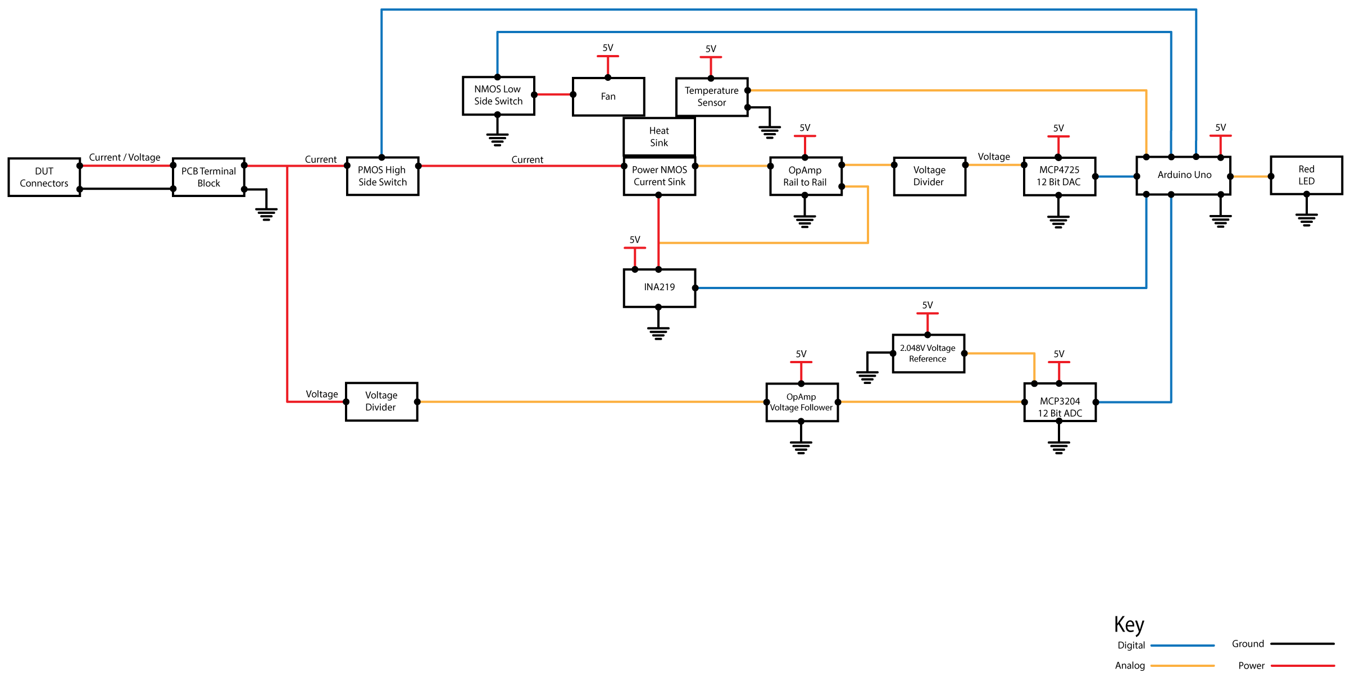
Hardware Block Diagram

Slide 8
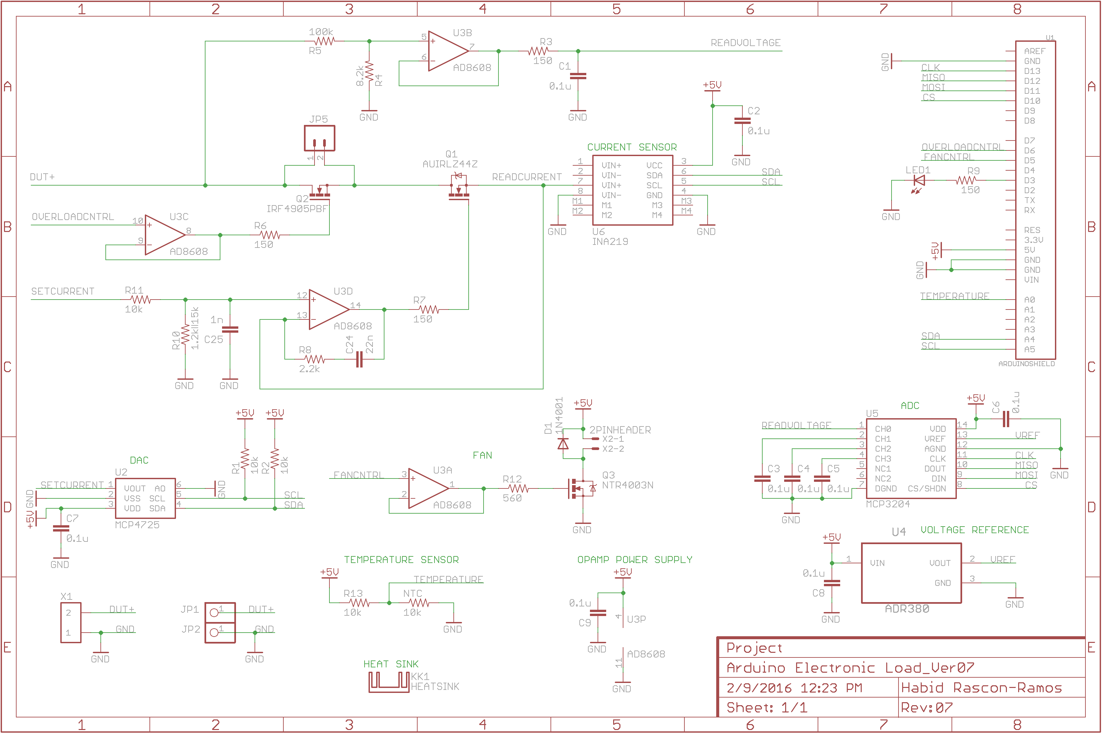
PCB Schematic

Slide 9
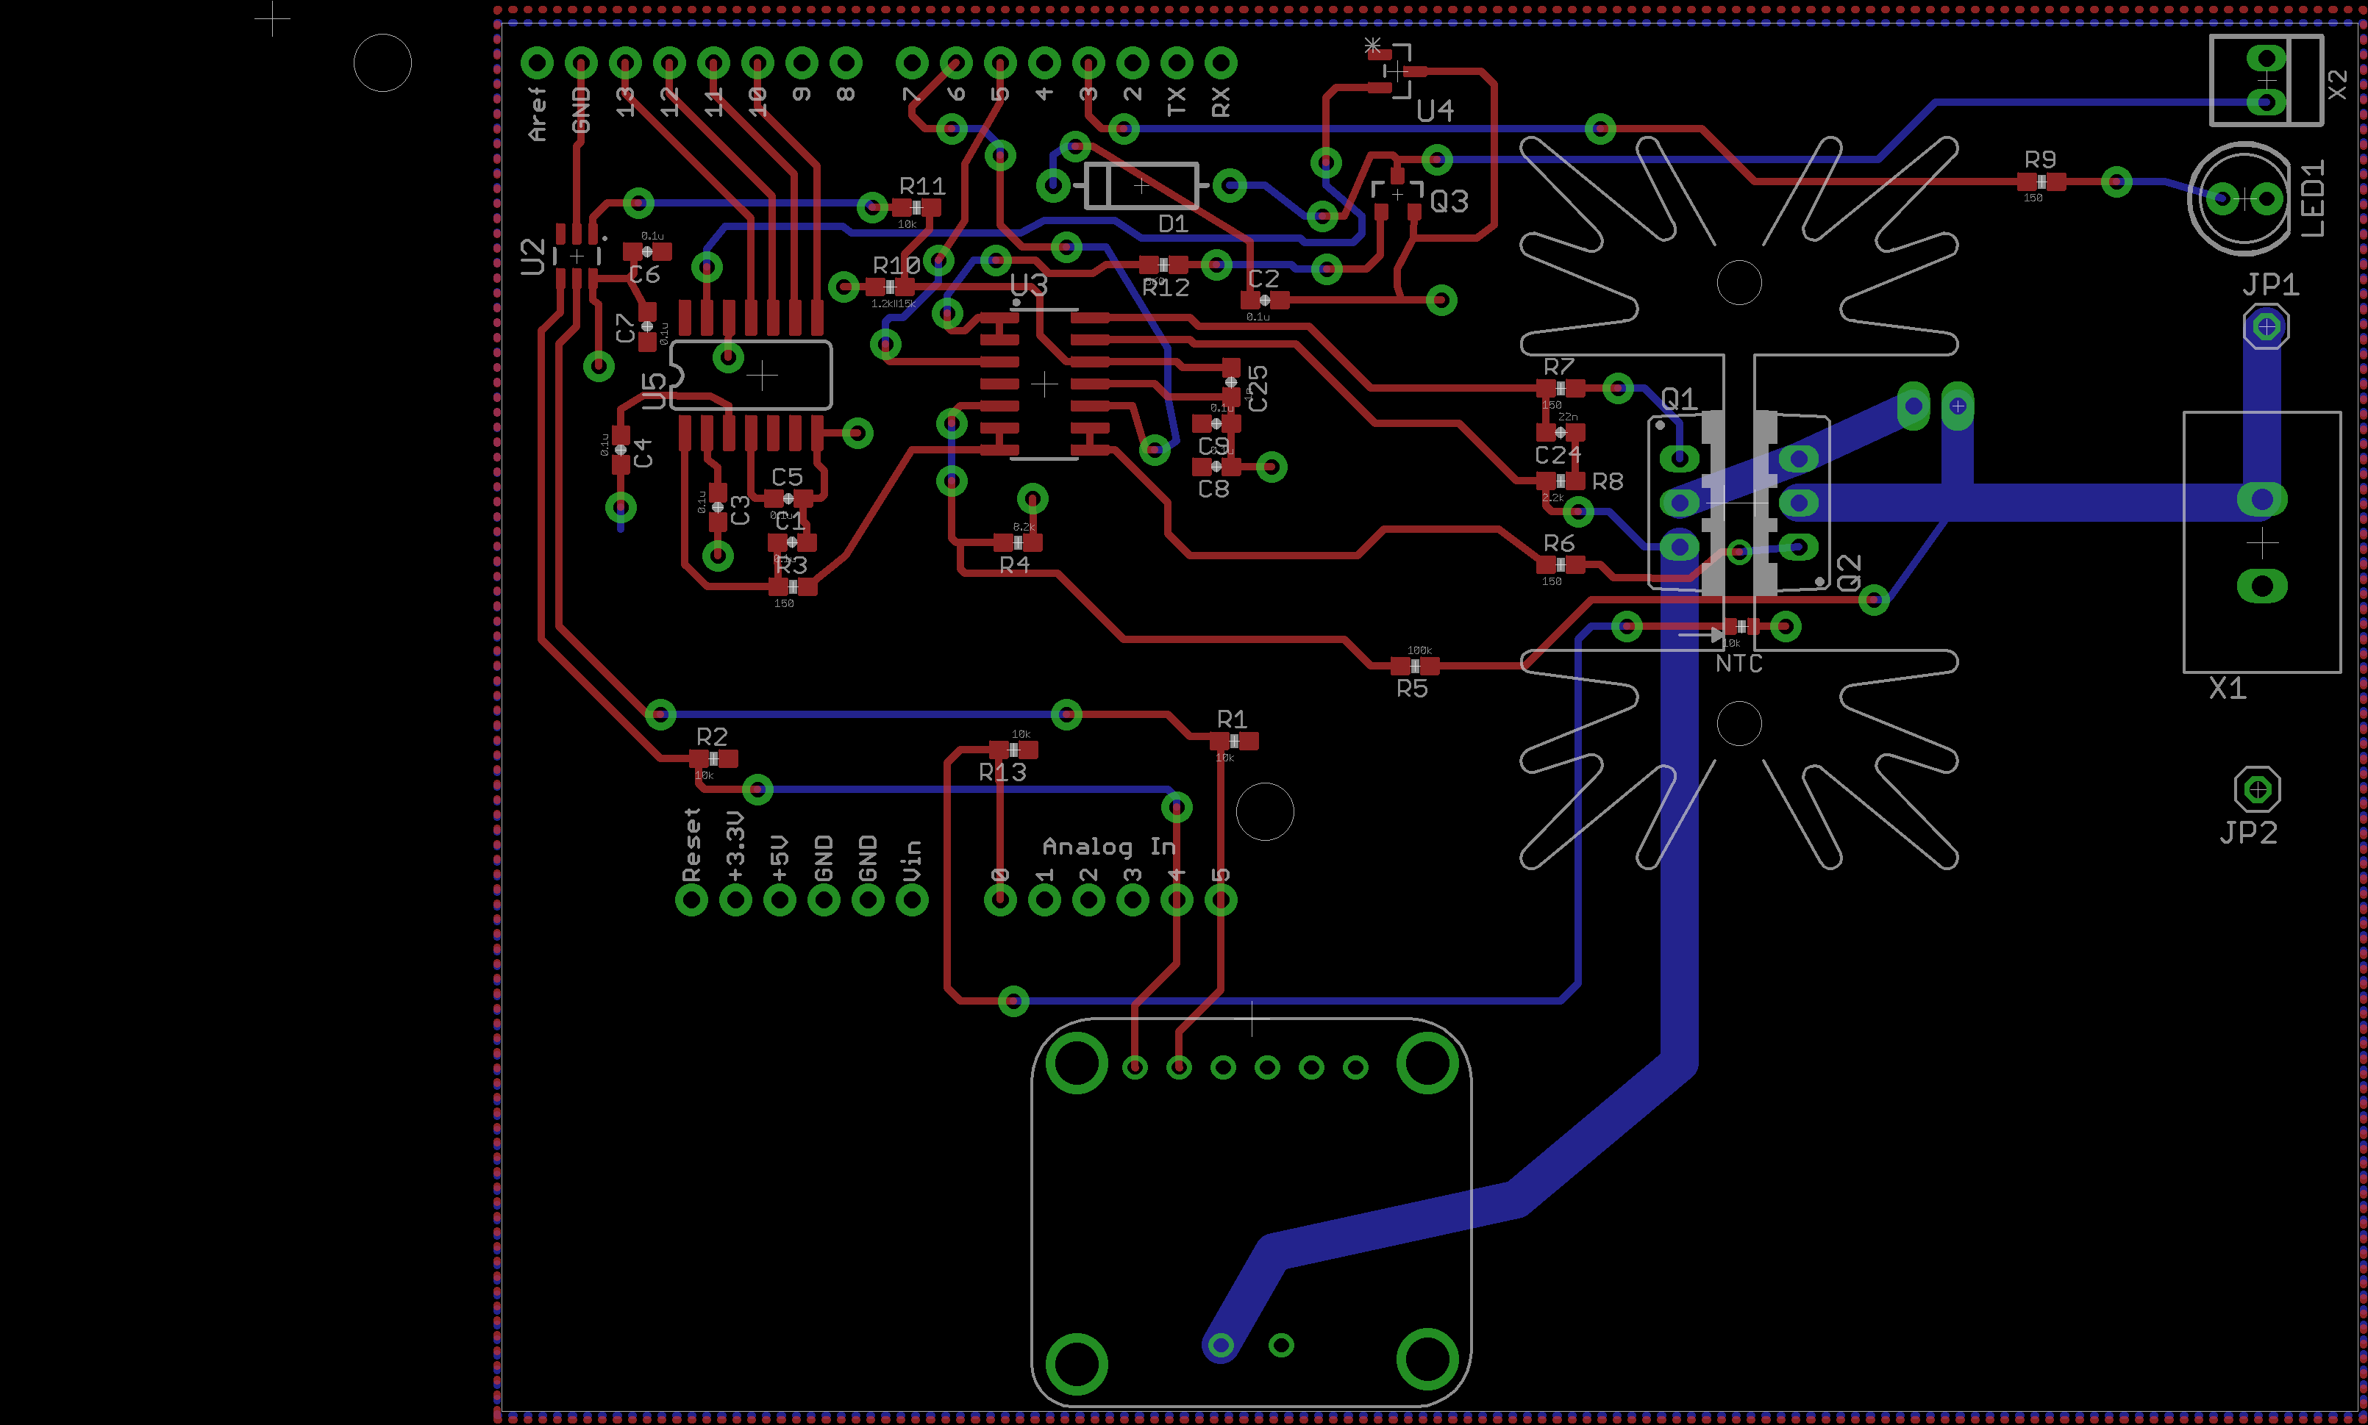
PCB Layout

Slide 10
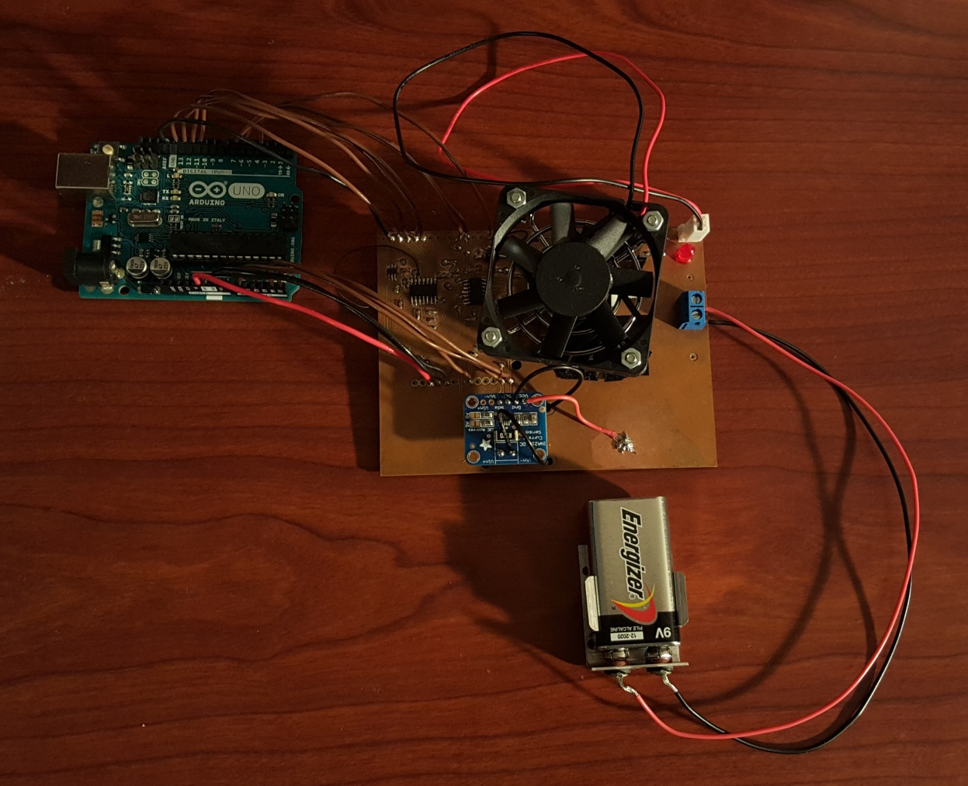
Final Product
Hardware

Slide 11
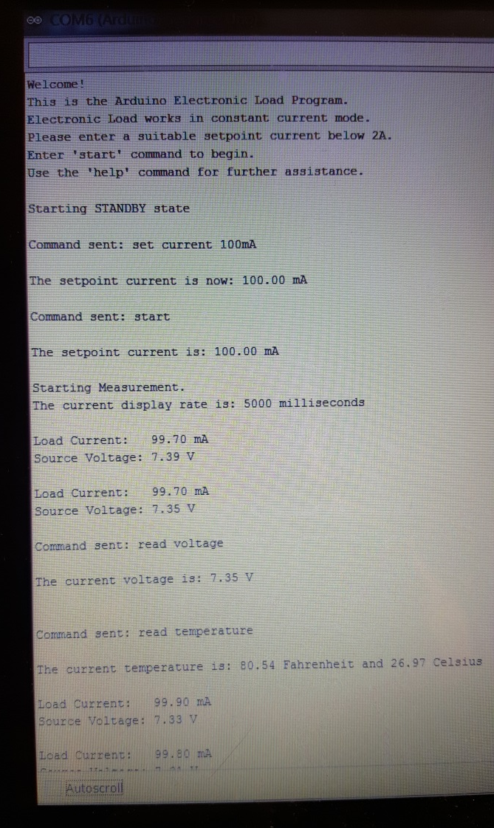
Final Product
Software

Slide 12
Results

